Slide 1
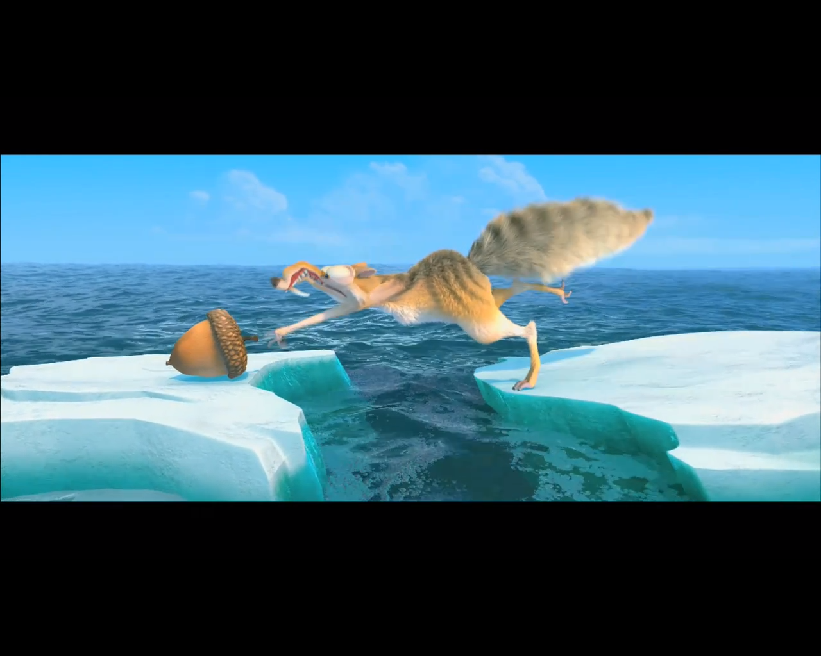
DOER Interconnection Data Analysis: Ferreting out the nut of the situation

Slide 2
 |  | Being Screened | Suppl Review | Follow-on Studies | Impact Study | Awaiting Cust Sign. | Detailed Study | Construction | Cancelled | Post ISA expedited or PostConstruction standard
97 | <BLANK> | Grid
225 | Impact Study Requested/Required |  |  |  | NSTAR, Grid
73 | <INFO REQUESTED> |  | NSTAR, Grid |  | NSTAR, Grid |  | NSTAR, Grid
67 | <CANCELLED> |  |  |  |  |  |  |  | Grid
38 | Impact Study Stage |  |  |  | NSTAR, Grid
33 | Awaiting Completion Doc |  |  |  |  |  |  |  |  | NSTAR, Grid
26 | Engineering Review Stage | NSTAR
6 | Awaiting results of meeting |  |  |  | NSTAR
8 | Awaiting impact study completion of other applicant on same ckt |  |  |  | NSTAR
4 | Awaiting impact study agreement and check |  |  |  | NSTAR
3 | Draft study and scope sent to customer. |  |  |  |  | NSTAR
2 | Awaiting completion of upgrades |  |  |  |  |  |  | NSTAR
598 |  | 123 | 24 |  | 308 | 4 | 26 | 4 | 67 | 33

